Slide 1

HARDWARE EDITION

Slide 2
Ministry Name: Ministry of Communications Problem Statement : Cost effective innovative solution for long distance (3 to 8 kms) Problem Code : PJ238 Category : Hardware Domain Bucket : Smart Communication Team Name : Team Hexa_SKN Team Leader Name : Sunidhi Pranjale College Code : 1-4266701337
Idea / Approach Details

Slide 3
Problem Statement Description
Cost effective innovative solution for long distance (3 to 8 kms) wireless (LAN) Broadband Connectivity to sparsely located individual households in rural areas (Last mile Connectivity) from Gram Panchayat (USO) ONT locations. Under Bharat Net project of Deptt. Of Telecom, fibres have reached to more than a lakh of Gram Panchayats. But extending broadband connectivity from these Gram Panchayat ONTs to individual households located at a distance of 3 to 8 km is a problem. Extending fibre to individual houses is expensive, messy and very difficult to maintain in far flung rural areas. WiFi connectivity has short range problem. Benefits: It can offer a cost effective solution to last mile broadband connectivity problem, which will facilitate greater broadband penetration to rural population. It will ensure the proper utilization of USOF Bharat Net fibre and also help in bridging the Digital Divide to a greater extent.

Slide 4
Implementation

Slide 5
Our solution consists of 2 parts
Part I:
Free Space Optical communication from Gram Panchayat (USO) ONT locations to sparsely located individual households in rural areas which are 3 – 10 kms far from these ONT locations.
Part II:
Last mile connectivity using hexagonal structure of routers.

Slide 6
Introduction of FSO ( Free Space Optical ) Communication using Laser
Free Space Optical communication FSO is an optical communication technology that uses light propagating in free space to wirelessly transmit data for telecommunications or computer networking.
Free space means air, outerspace, vaccum or something similar. This contrasts with using solids such as optical fiber cable or an optical transmission line.
The FSO technology is useful where the physical connections are impractical due to high costs or other considerations.
The fundamental elements of FSO system are FSO transmitter, an FSO channel and an FSO receiver.

Slide 7
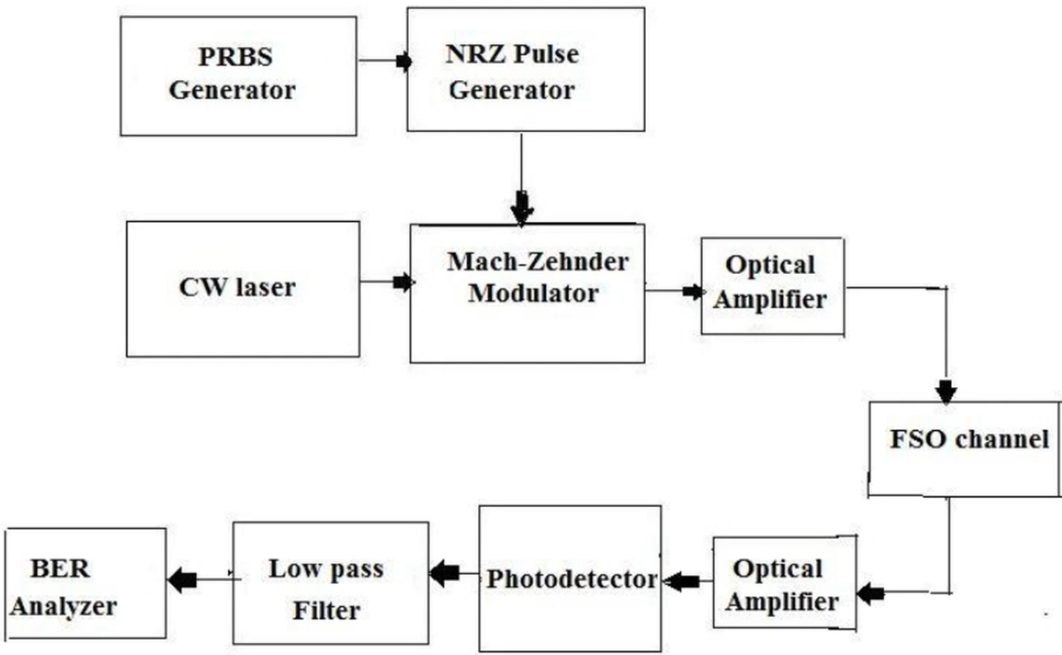
Block Diagram

Slide 8
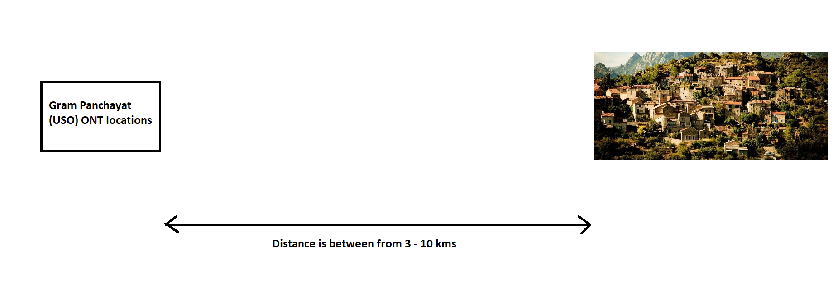

Slide 9
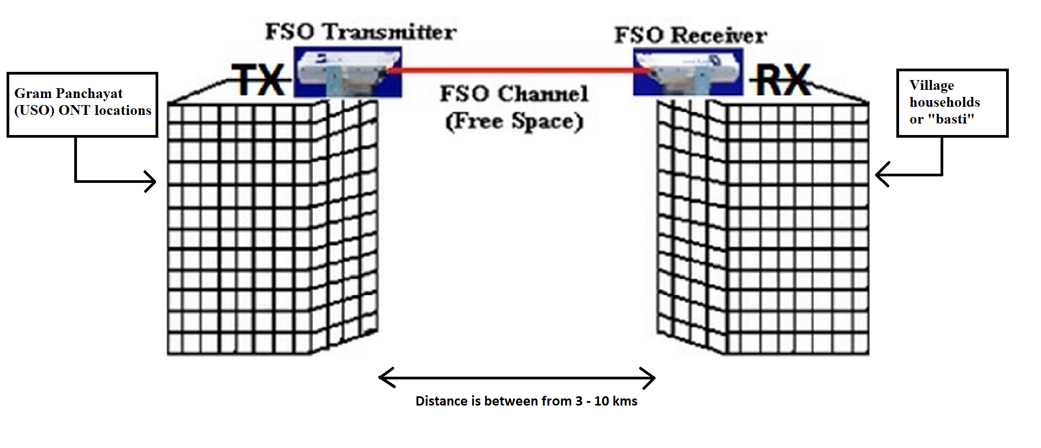

Slide 10
Design And Simulation

Slide 11
Video of design and simulation

Slide 12
Last mile connectivity using hexagonal structure of routers.

Slide 13
Shantanu video recording

Slide 14
Prototype

Slide 15
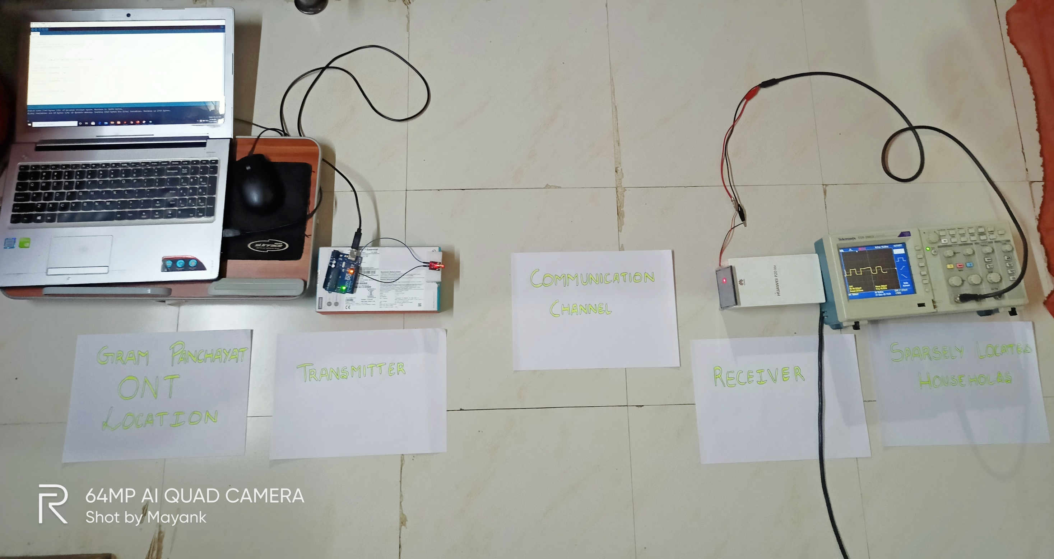

Slide 16
Advantages:
Higher Bandwidth
Low probability of intercept for higher security
Low power requirements
Smaller packaging
Portable
Applications in Internet of Things (IoT)

Slide 17
Factors affecting free space optics:
Environmental Factors: Such as
atmospheric attenuation
window attenuation
alignment or building motion
solar interference

Slide 18
OUR PLAN
Direct LOS communication with horizontal movement of laser so that it can avoid the interference
of birds or anything in between.
Use of Repeaters at some other buildings or at some other way as shown in video
( We ll be sending ARP protocols to first plan, if the transmitter didn’t receive any authentication from
receiver, then will activate Plan B and when it receives the authentication, Plan B will be shut down and
will again activate Plan A and the process continues. )

Slide 19
THANK YOU

